Slide 1

ANIMAL TARGET PREDICTION - TIPS
Several methods available for miRNA target prediction (e.g. TargetScan, miRanda, RNAhybrid)
Use a combination of seed matching, MFE (duplex stability) and 3’ complementarity (poorly understood)
High false positive rates
Some miRNAs predicted to target >25% of all human genes
Little overlap between methods
Small increase in accuracy reduces time spent validating
The Genome Analysis Centre

Slide 2
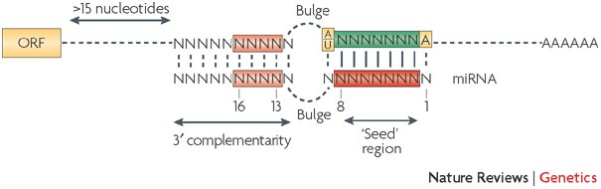
PROBLEMS WITH FINDING TARGETS
Target prediction relies on finding “seed site” matches in the 3’ UTR
Only 80% of interactions have seed site matches
Only half of those have perfect seed complementarity
Probability of finding a perfect or imperfect match in e.g. 2Kb 3’ UTR sequence is very high
Scaled up across all genes = many false positives
Need extra information!
Perfect seed match = 2Kb / 4^7 = 0.12
Imperfect seed match 2Kb / 4^6 = 0.49
The Genome Analysis Centre

Slide 3
MIRNA TARGET PREDICTION - TIPS
PROBLEMS WITH FINDING TARGETS
The Genome Analysis Centre

Slide 4
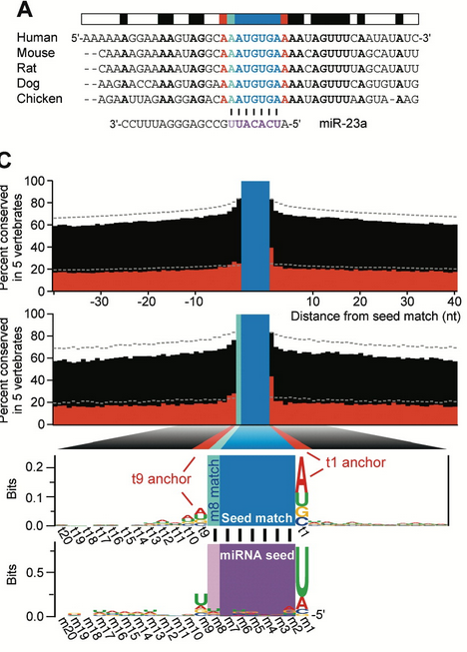
TARGET CONSERVATION
miRNAs tend to have conserved function and targets
Can use cross species conservation to improve prediction – high confidence targets
Lower conservation in 3’ UTRs but functional motifs (e.g. target sites) are strongly conserved
Drawback: not all targets are conserved!
The Genome Analysis Centre

Slide 5
EXPRESSION FILTERING
Researchers interested in the role of miRNA(s) in a context specific manner
Prediction algorithms find all potential targets
Predicted target
genes
Genes expressed
in cell line of interest
FilTar tool
Use expression data (RNA-Seq) to filter target predictions in a tissue/developmental stage dependent manner
Many will be false positives in the tissue of interest
False positive
predictions
Potential target
No target
Gene and miRNA must be expressed in same cell to interact!

Slide 6
EXPERIMENTAL METHODS
Control
miRNA perturbed
RNA-Seq
Differentially expressed genes
Check 3’ UTRs of DE genes for miRNA target/seed sites
miRNA overexpressed – downregulated genes are potential targets
miRNA repressed – upregulated genes are potential targets

Slide 7
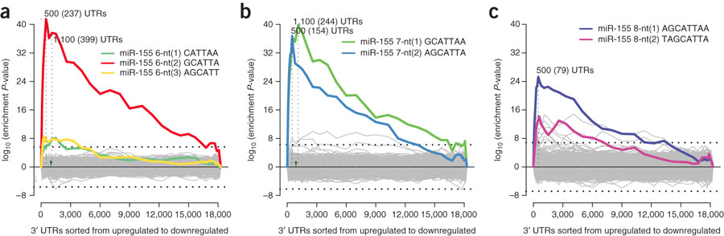
EXPERIMENTAL METHODS
Tools e.g. Sylamer to check experiment
Input: ordered gene list & 3’ UTRs
Output: enrichment analysis for miRNA seed sites in DE genes between control and miRNA perturbed
miR-155 downregulated

Slide 8
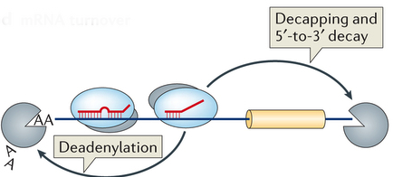
EXPERIMENTAL METHODS
AGO CLIP allows us to identify target sites on a transcriptome-wide scale
UV crosslink protein to RNA
Partial digestion
Pull down with AGO specific antibody

Slide 9
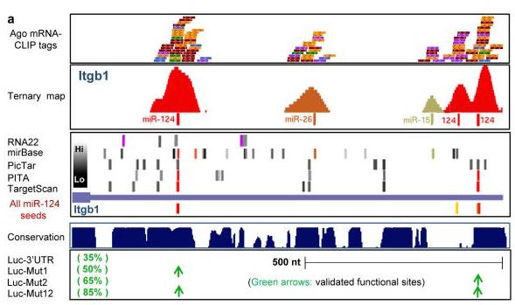
EXPERIMENTAL METHODS
Nature. 2009 Jul 23; 460(7254): 479–486.

